Slide 1
Chatbot Test Automation
Group Industrialization & Automation
April 2020

Slide 2
Chatbot Test Automation
Test Automation with Python
Key Functionality
To automate execution of regression tests of chatbots (started with MAIA for Automation)
UI-based testing using web elements from the HTML DOM structure
Open Source Libraries
Using free open source Python libraries
Selenium 3.141.0 using Chrome Driver 2.35.528161, Beautiful Soup 4
Leveraged Selenium code for extraction from earlier MAIA Implementation
Reusable and Customizable
Can be customized to reuse across different chatbot implementations
Configurable – to increase reusability quotient
Dependency
Need python developer to customize, extend and maintain the scripts
Vendor Agnostic
Tested for Microsoft Bot Framework
Approach can potentially be used to test chatbots built using other technologies
Business Drivers
Regression testing
Reduce time and effort
Improve the product quality
detecting detect early
Increase test availability

Slide 3

High Level Approach
QnA
List
API
Testing
Knowledge
Engineering
Template
Test Mode
Selection
User/Developer/
Question
List
UI
Testing
In the knowledge engineering sheet depending on the type of question, we have to manually enter a field which will decide if that question requires UI testing or API testing.
If the answer to a particular question contains a lot of UI based content, then it will undergo UI testing .
For the questions that only depend on the content, it will undergo API testing.

Slide 4
API Testing

Slide 5
Auto Suggestion Testing

Slide 6
UI Based Testing
Generator
Question-List
Key Functionality: Generates answers for the questions
Input File: 'Question-List.xlsx’
Output File: ‘Test-Input.xlsx'
Chatbot
Under
Test
Test-Input
Test Scenarios handled
Executor
Key Functionality: Automates the test execution
Input File: ‘Test-Input.xlsx’
Output File: 'Test_Result.xlsx'
QnA
Search
Test_Result
Notes:
Add from the read me file

Slide 7
Scenarios in UI Based Testing
QNA’s – The test script extracts the entire FAQ answer and processes it. The procedure to extract the answer will vary for basic FAQ and extended FAQ.
Multiprompt –The test script extracts a particular text and returns the buttons displayed in a JSON format along with the text.
Extended QNA(Text followed by buttons) – For this case the buttons are returned in a JSON format and placed in an outer JSON while the text in the response is returned as another element in the outer JSON.
Search – For search, if the test script extracts both valid and invalid responses it is successful and it is unsuccessful if it returns any error message from the Sinequa API.

Slide 8
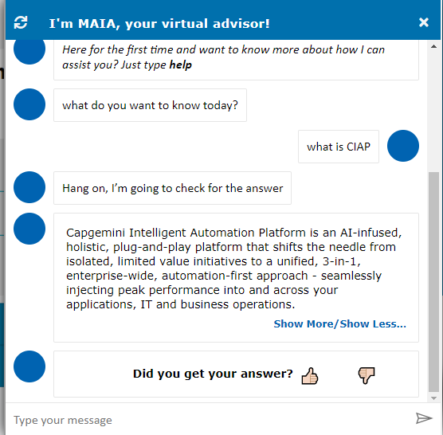
Testing QnAs scenario
Sample QnA Scenario
Generator
Question-List
Chatbot
Under
Test
Test-Input
Executor
Test_Result
Question triggered in the chatbot UI through Selenium driver
Based on bot response, test scripts detects if it’s an FAQ scenario
Answer is extracted and processed for validation
This process would differ based on FAQ variations (basic, extended or bot prompts)

Slide 9
Dialog Flow Testing

Slide 10
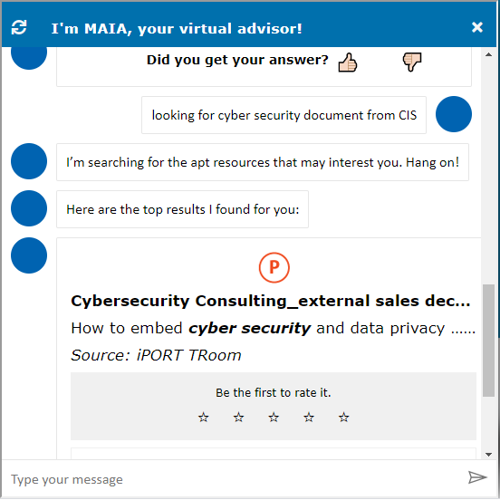
Testing Search scenario
Sample Search Scenario
Generator
Question-List
Chatbot
Under
Test
Test-Input
Executor
Test_Result
Search Query is triggered in chatbot UI through Selenium driver
For search scenario, test script detects whether it’s a valid or invalid response (i.e. results found or not)
The test is successful if valid and invalid responses extracted are as expected
The test fails if call to Sinequa doesn’t go through and an error message is generated in the response

Slide 11
Conclusion
Implementation Process
Understanding System Under Test
Understand the functionality
Analyze the UI Design (html structure)
Customization
Configuration
Code Change
Setup & Handover
Scope of Testing across implementations
MAiA for Automation
Cisco
MAIA for Quality - WIP
MAIA for HR – to be done
Benefit
Quantitive Benefit
Average Effort Saved (in Hrs) 11.02
Average Effort Saved is in the range of 25 to 30 percent
Qualitative Benefit
Automated test execution frees up team member's time
Can be executed at any time based on the application availability
Test result will be more objective and accurate
Next Steps
Make it robust for QnA scenarios across different implementations (Test for HR)
Test menu-driven bots
Test bot prompts cases for QnAs
Test dialog based scenarios

Slide 12
Thank You
Please contact for any queries
Sindhu Bhaskaran
Senior Director, Group Industrialization & Automation
(Sindhu.Bhaskaran@capgemini.com)
Shreyas Bhargave
Director, Group Industrialization & Automation
(Shreyas.Bhargave@capgemini.com)

Slide 13
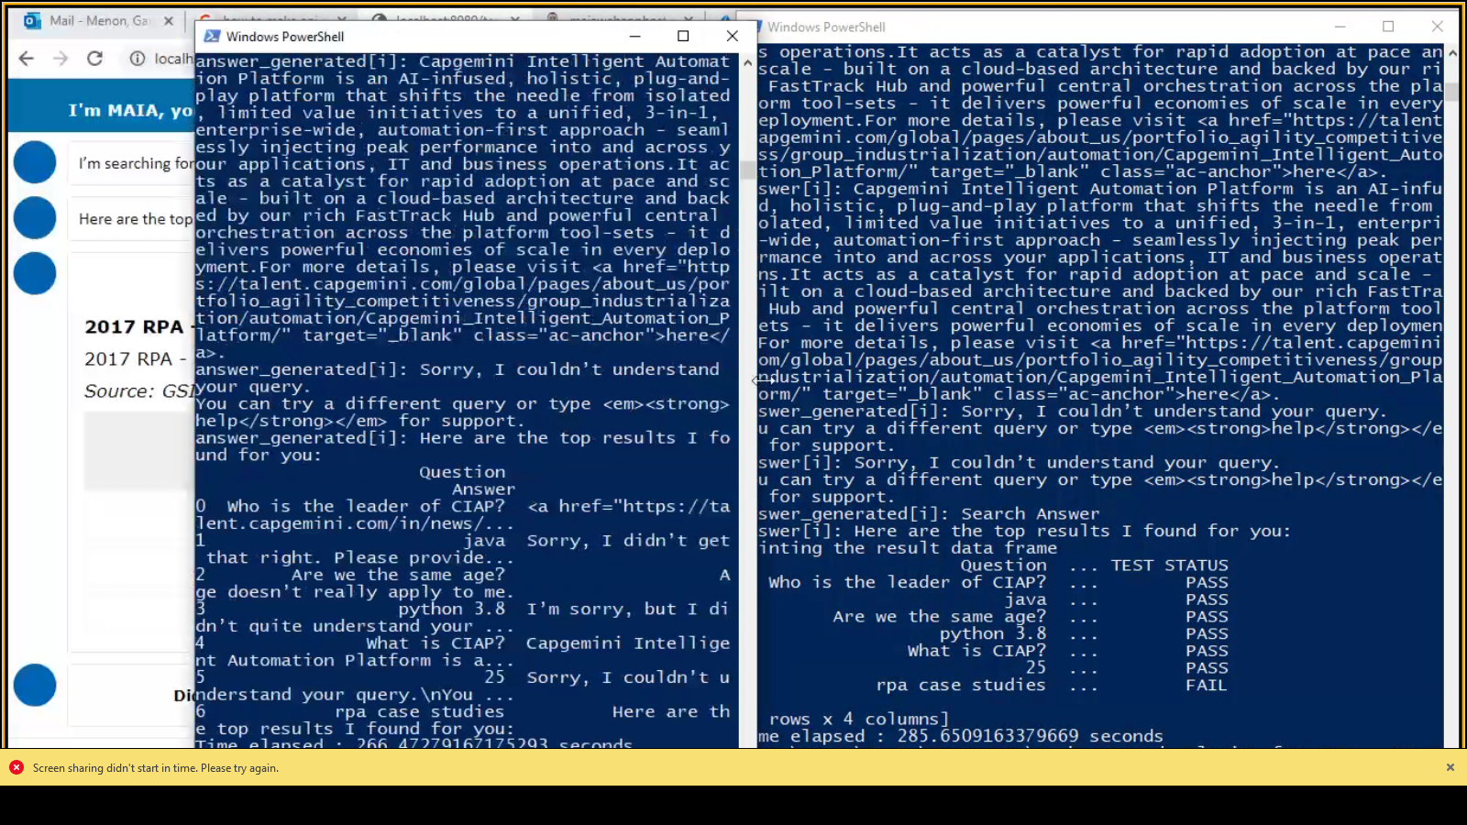
Conclusion

Slide 14
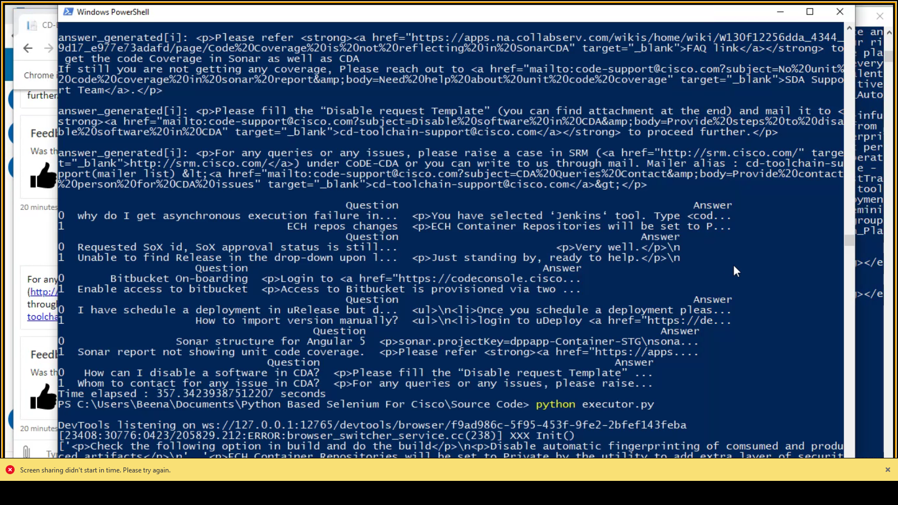
Conclusion

Slide 15
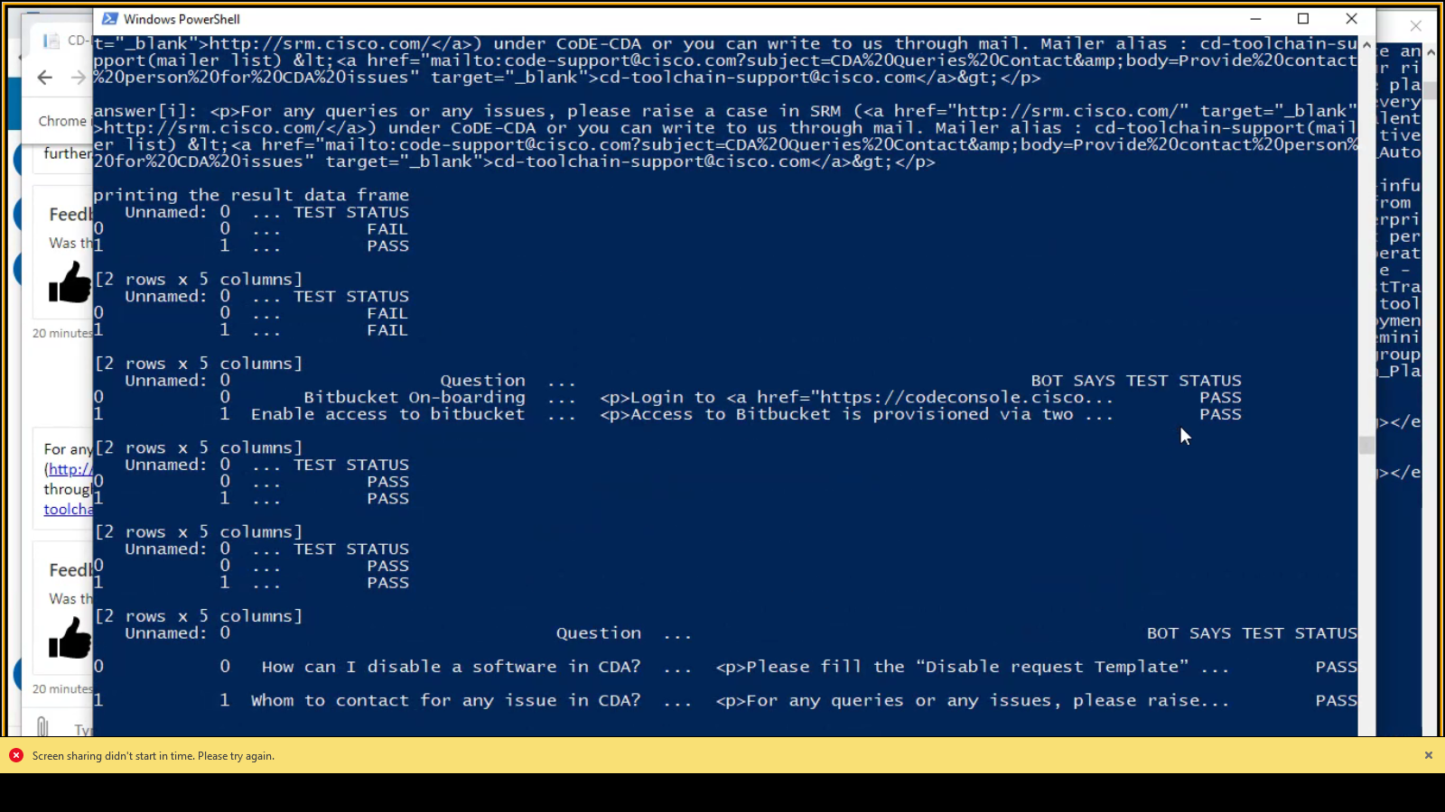
Conclusion

Slide 16
Comparative Analysis
Findings | Botium | Microsoft | Selenium
Key Features | CI/CD Integration API Level testing **No GUI support for testing | Unit testing Functional tests Trace activity on error handler | Data driven test Keyword driven test Hybrid test **Supports GUI (Web based application)
Development Effort | Quick start wizard (predefined testsets and enviroments). Less coding skill required Botium connectors NLU/NLP and Analytics | Medium coding skill required Ease of implementation for Microsoft developer | High level of coding required Reusability and Integration Ease of Implementation
Learning Curve | Generic skills (Text / Excel) Easy quick start setup | Easy and intuitive to create coded unit tests Easy to understand the cause of the failure and the test output | Java/Python/.Net coding skill Supports various Programming languages
Flexibility | Less test sets(when running large data set) Specialized only for Chatbot Built-In Reporting | Emulators for testing Different types of data driven test Mock objects (dispatcher0 for the different dependencies of a dialogue (i.e. LUIS recognizers, etc) DialogTestClient (Target channels (Teams, Slack, Cortana, etc.) | Supports large test sets Mobile testing Web application (Chatbot testing using WebDriver)
Prerequisite | Botium 1.8 – Visual studio code, Node & NPM | Microsoft.Bot.Builder.Testing package | Python, XLRD, openpyxl, Panda
Platform support | Windows, Linux | Windows | Windows, Mac OS, Linux, Solaris
Pricing | Freeware Community Groups SaaS: Professional – 429 € /month Botium Box Professional Edition for small project EnterpriseBotium – 999 € /month Box Enterprise Edition for midsize projects. | Free (Join for free) (Unlimited repositories) Standard Channels (Unlimited messages) Premium Channels (10,000 messages/month) LUIS Free web container (10.000 transaction per month) Standard Web/container ($1.50 per 1000 transaction) | Freeware (Open source) Official User Group Chat Room and Slack Commercial Support Selenium Sponsors (No tech support) (Sponsors : BrowserStack, SAUCELABS, experitest, CrossBrowserTesting…..etc)

